Slide 1

Module 2
Exploratory Data Analysis (EDA)
Notes:
Guidelines
Use section headers to chunk content in your presentation.
Use the same style of section header throughout your presentation.
Keep your title to no more than 2 lines.

Slide 2

EDA – Missing Values, Transformations
Notes:
Guidelines
Use a title slide at the beginning of your presentation. There are 9 variations of title slides to choose from.
If you will have a series of slideshows, we recommend using the same style of title slide for each presentation.
Keep your title to no more than 2 lines.
Do not change the font style or font size of the title or subtitle.

Slide 3
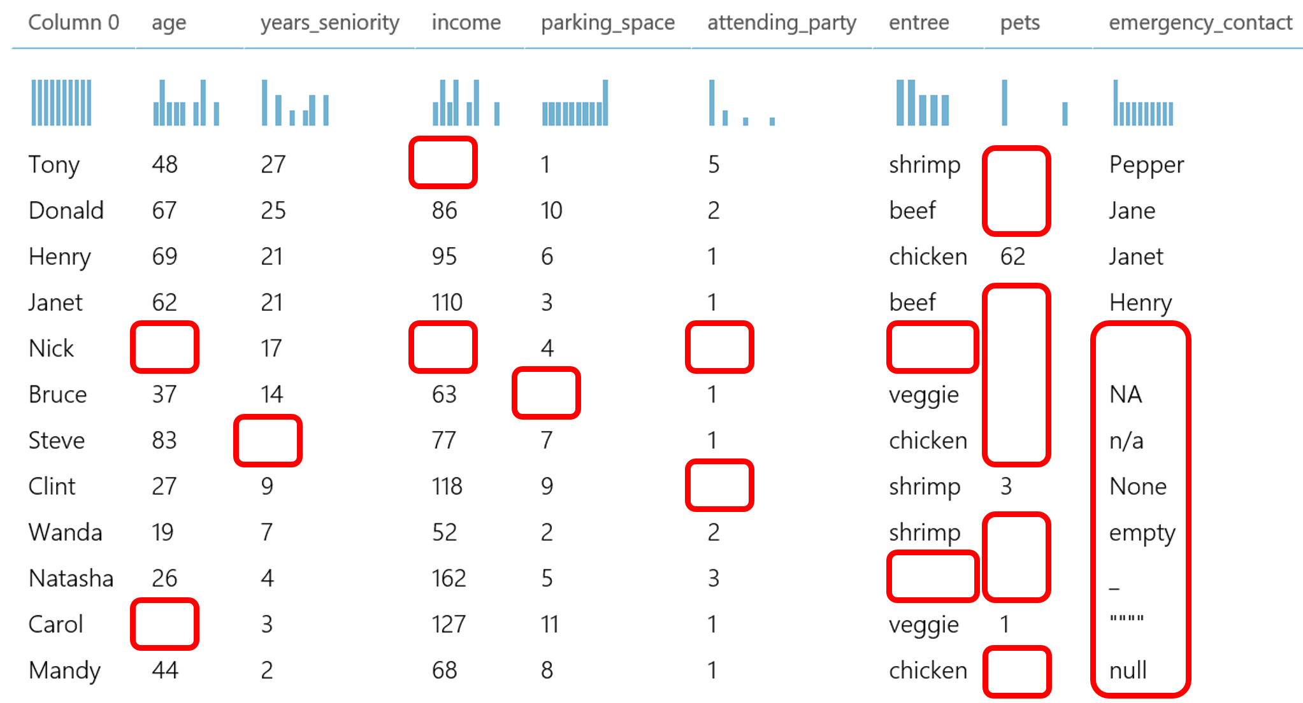
Missing Values
Missing values can be problematic with any model
Models generally assume no missing values in any variable

Slide 4
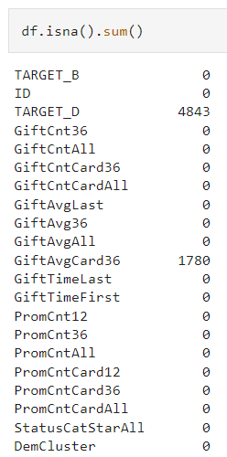
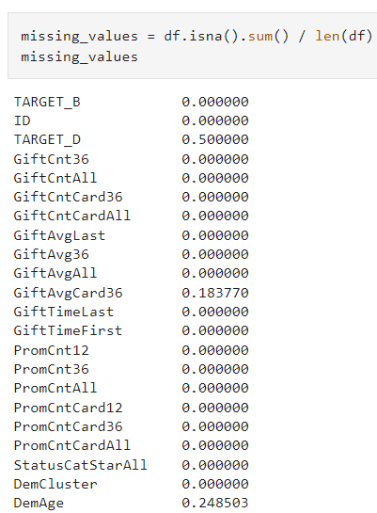
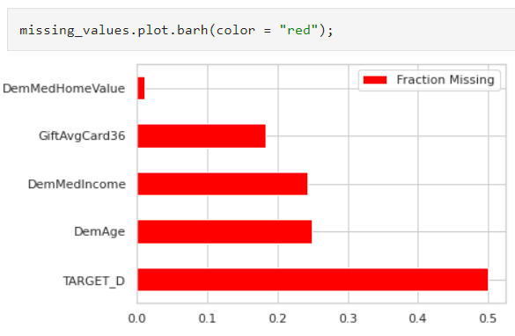
Checking for Missing Values
It is important to get a summary of missing values per variable

Slide 5
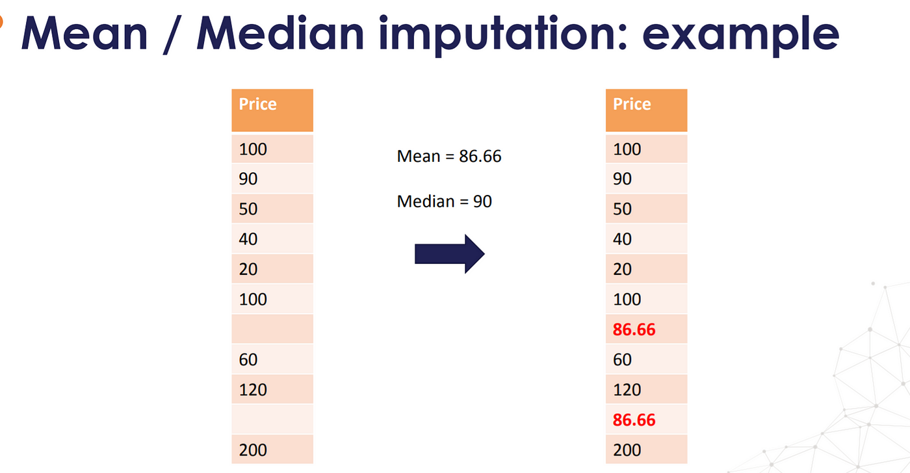
Imputation of Numeric Variables
Imputing means replacing missing value with an estimate
Common numeric estimates are the mean and median
Mean Imputation
Median Imputation
Model-Based Imputation

Slide 6
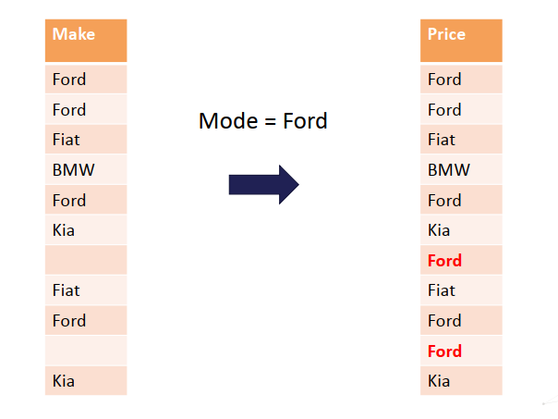
Imputation of Categorical Variables
Categorical variables can be imputed with the mode or new level
Mode Imputation
Imputing with new level “missing”

Slide 7
Missing Value Indicator Variables
It is a dummy variable {0,1} that shows when missing imputed
0
0
0
0
0
0
1
0
0
1
0

Slide 8
Python
Notes:
Guidelines
Use a title slide at the beginning of your presentation. There are 9 variations of title slides to choose from.
If you will have a series of slideshows, we recommend using the same style of title slide for each presentation.
Keep your title to no more than 2 lines.
Do not change the font style or font size of the title or subtitle.

Slide 9
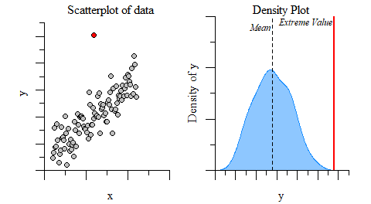
Unusual Values
Unusual values and outliers affect model performance
We should check for these in EDA

Slide 10
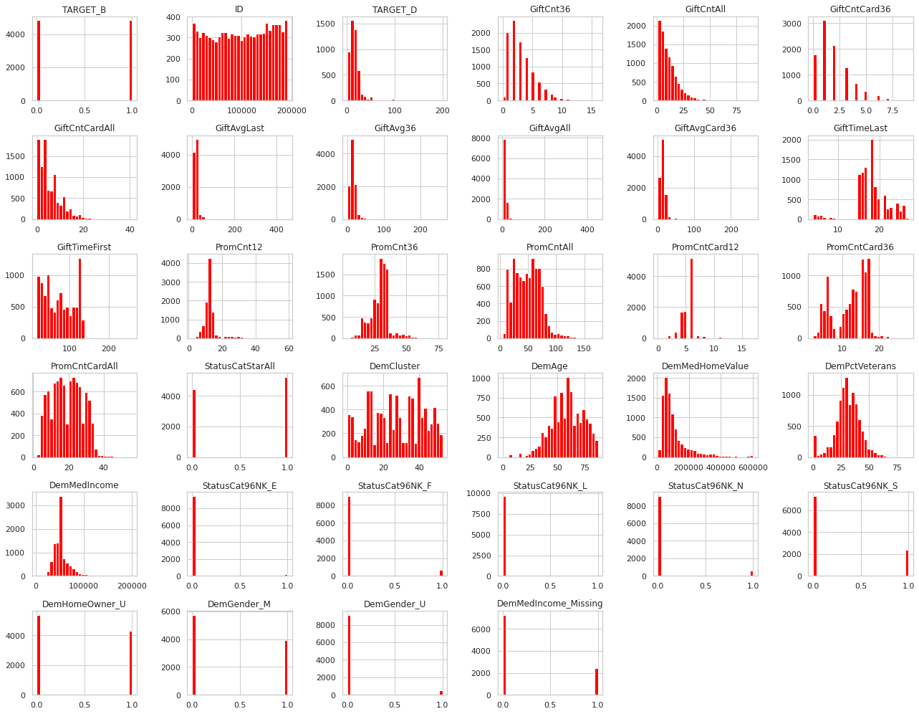
Unusual Values

Slide 11
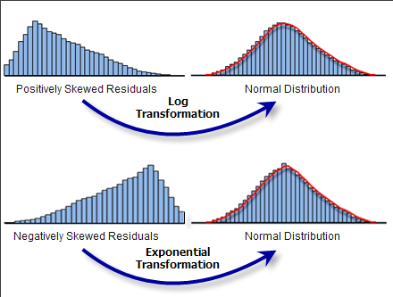
Transformations
A way to make the data work better in your model
Particularly helpful in logistic regression and neural networks

Slide 12
Python
Notes:
Guidelines
Use a title slide at the beginning of your presentation. There are 9 variations of title slides to choose from.
If you will have a series of slideshows, we recommend using the same style of title slide for each presentation.
Keep your title to no more than 2 lines.
Do not change the font style or font size of the title or subtitle.

